Slide 1
Lecture 18
Sampling Distributions, the Central Limit Theorem and Confidence Intervals

Slide 2
Review
1 What is a Poisson random variable?
The number of events in a fixed interval, when events occur independently at an average rate λ.
2 What is a probability density?
How concentrated probability is around a point; probability is the area under the curve.
3 For a continuous random variable, what is P(X = c)?
0: a single value has no width, so it has no area under the curve.
4 What is a cumulative probability?
P(X ≤ x): the area to the left of x, what the z-table and pnorm give.

Slide 3
Two polls, two answers
Two polling firms each survey a random sample of 1,000 voters in the same state, in the same week.
Poll A: p̂ = 0.52 Poll B: p̂ = 0.49
(a) Is one of the polls wrong?
(b) If 1,000 firms each polled 1,000 voters, what would their 1,000 values of p̂ look like?
(a) Not necessarily: different random samples give different values of p̂
(b) A pile of values centered near p: the sampling distribution of p̂

Slide 4
Three distributions
population distribution
how a single observation X varies; described by parameters such as μ, σ and p
data distribution
the n values in our one sample; described by statistics such as x̄, s and p̂
sampling distribution
how a statistic such as x̄ varies over all possible samples of the same size n

Slide 5
Building a sampling distribution
A spinner lands on 1, 2 or 3, each with probability 1/3. Spin it twice and record the mean, x̄.
μ = 2; n = 2 spins; 3 × 3 = 9 equally likely samples (order matters)
(a) List the 9 samples and the mean of each.
(b) What is P(x̄) for each possible value of x̄?
(a) (1,1) → 1; (1,2), (2,1) → 1.5; (1,3), (2,2), (3,1) → 2; (2,3), (3,2) → 2.5; (3,3) → 3
(b) x̄ = 1, 1.5, 2, 2.5, 3 with P(x̄) = 1/9, 2/9, 3/9, 2/9, 1/9

Slide 6
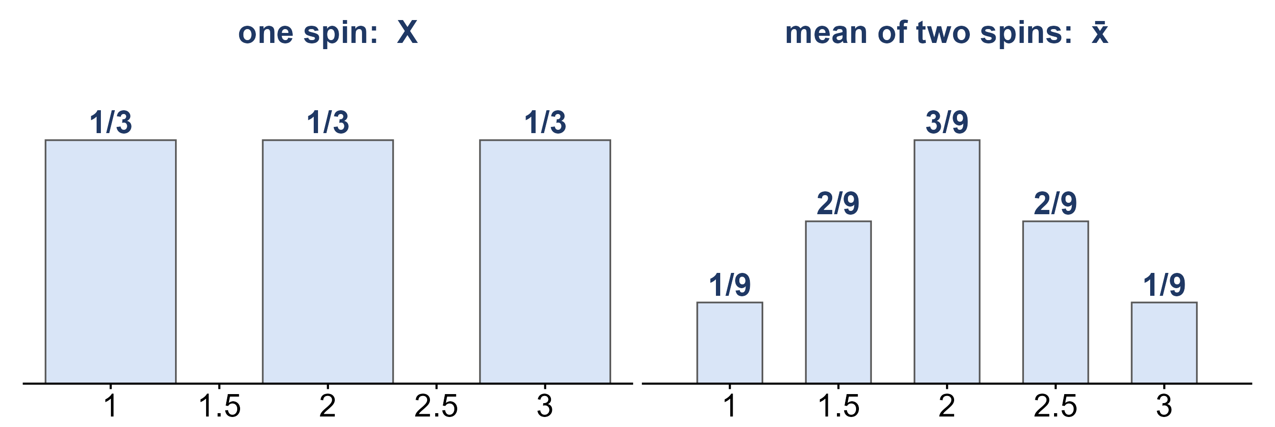
One spin vs. the mean of two spins
The population (left) and the sampling distribution of x̄ for n = 2 (right).
What stayed the same? What changed?
Same center: both have mean 2. Smaller spread: σ = 0.82, σ_{x̄} = 0.58 = 0.82 / √2
New shape: peaked in the middle

Slide 7
Center and spread of x̄
mean of x̄
μ_{x̄} = μ: x̄ is centered at the parameter it estimates
standard error of x̄
σ_{x̄} = σ / √n: the spread of x̄, which shrinks as n grows
the sample proportion p̂
mean p and standard error σ_{p̂} = √(p(1 − p) / n)

Slide 8
Data: Spotify songs
Spotify and YouTube statistics for the top 10 songs of each of 2,079 popular artists, collected in February 2023.
X = the length of a song, in minutes
TRACK | ARTIST | MINUTES
Feel Good Inc. | Gorillaz | 3.71
Rhinestone Eyes | Gorillaz | 3.34
New Gold (feat. Tame Impala and Bootie Brown) | Gorillaz | 3.59
On Melancholy Hill | Gorillaz | 3.90
Clint Eastwood | Gorillaz | 5.68
… | … | …
18,860 different songs (a song credited to several artists is counted once)

Slide 9
Example: standard error and n
Treat the 18,860 songs as the population. Draw a random sample of n songs and average their lengths to get x̄. Every new sample gives a different x̄; the standard error σ_{x̄} measures how much x̄ varies from sample to sample.
μ = 3.71 min; σ = 1.51 min
(a) What is σ_{x̄} for n = 20?
(b) What is σ_{x̄} for n = 80?
(c) How much larger must a sample be to cut the standard error in half?
(a) 1.51 / √20 ≈ 0.34 min (b) 1.51 / √80 ≈ 0.17 min
(c) 4 times larger, because √4 = 2

Slide 10
Data: waiting for a goal
The 2022 World Cup had 172 goals in 64 matches: 2.69 goals per 90-minute match.
X = minutes until the next goal, simulated at 2.69 goals per 90 minutes
WAIT | MINUTES
1 | 1.6
2 | 54.3
3 | 57.3
4 | 27.2
5 | 18.3
… | …
μ = 90 / 2.69 ≈ 33.5 min; σ ≈ 33.5 min. Most waits are short and a few are very long.

Slide 11
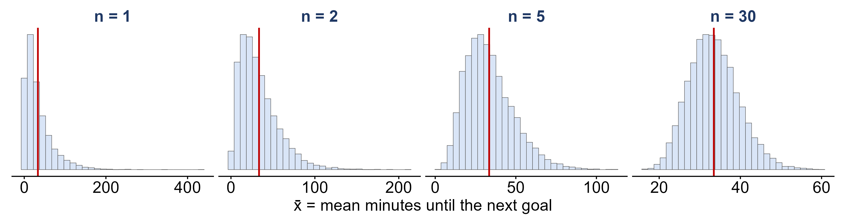
Averaging a skewed variable
Each panel: draw n waits, average them to get x̄, and repeat 10,000 times (n = 1 is a single wait).
As n grows, what happens to the shape, the center and the spread of x̄?
Shape: the skew fades into a bell. Center: stays at 33.5. Spread: shrinks like σ / √n

Slide 12
The central limit theorem
central limit theorem
for large n, x̄ is approximately N(μ, σ / √n), whatever the shape of the population
how large is large enough?
n ≥ 30 for x̄; np > 5 and n(1 − p) > 5 for p̂
why it matters
the empirical rule applies: about 95% of samples give a statistic within 2 SE of its mean

Slide 13
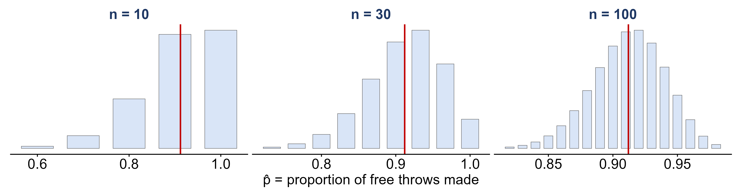
The CLT for a proportion
Exact sampling distributions of p̂, the proportion of free throws Stephen Curry makes; p = 0.912.
For which n is n(1 − p) > 5? Which distributions look like a bell?
n(1 − p) = 0.88, 2.64, 8.8: only n = 100 passes, and only n = 100 is close to a bell

Slide 14
Example: free throws, again
Over a stretch of n = 100 free throws, let p̂ be the proportion Curry makes.
p = 0.912; n = 100; n(1 − p) = 8.8 > 5
(a) What are the mean and standard error of p̂?
(b) About 95% of the time, p̂ falls between what two values?
(a) mean 0.912; SE = √(0.912 × 0.088 / 100) ≈ 0.028
(b) 0.912 ± 2(0.028): 0.856 to 0.968

Slide 15
Example: a tournament’s average
Goals per World Cup match: X ~ Poisson(λ = 2.69). A tournament averages over 64 matches.
μ = λ = 2.69; σ = √2.69 ≈ 1.64; n = 64
(a) What is the standard error of a tournament’s average?
(b) About 95% of tournaments average between what two values?
(c) The 2018 World Cup averaged 169 / 64 = 2.64 goals per match. Surprising?
(a) 1.64 / √64 ≈ 0.205
(b) 2.69 ± 2(0.205): 2.28 to 3.10 goals per match
(c) No: 2.64 is well inside 2.28 to 3.10

Slide 16
From an estimate to an interval
point estimate
a single statistic used to estimate a parameter: x̄ for μ, p̂ for p
confidence interval
a range of plausible values for the parameter: estimate ± margin of error
95% confidence
the method captures the parameter in about 95% of all possible samples

Slide 17
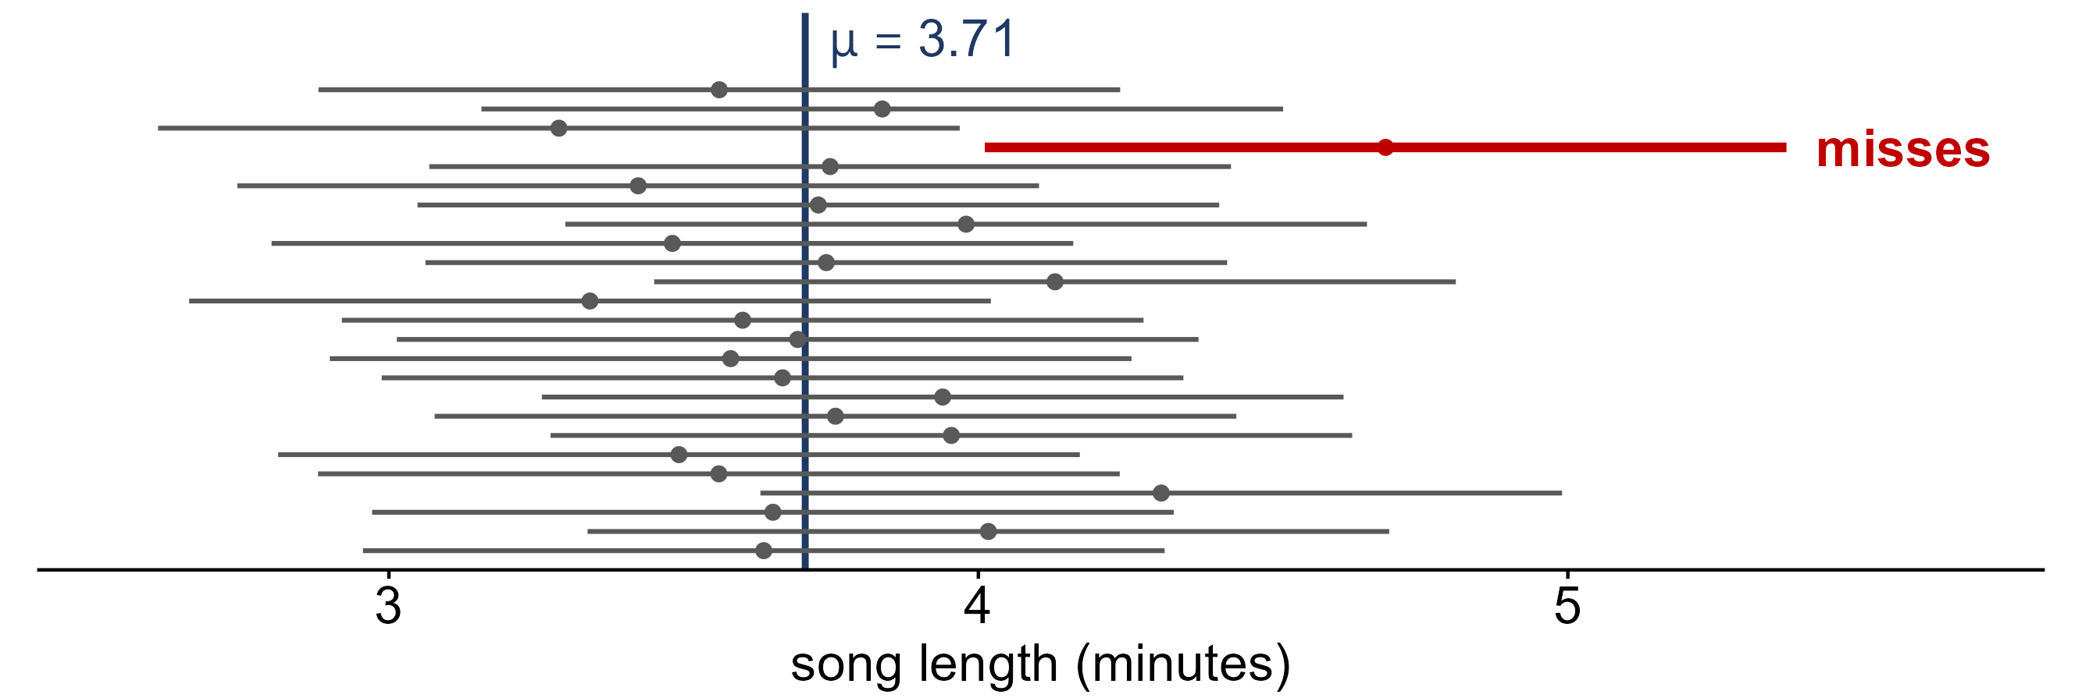
How often does an interval capture μ?
25 random samples of n = 20 songs; each line is x̄ ± 2(0.34), the margin of error.
How many of the 25 intervals capture μ = 3.71?
24 of 25: about 95% of intervals made this way capture μ

Slide 18
Example: an interval for mean song length
In practice we see only one sample: n = 20 songs (the bottom interval on the last slide).
x̄ = 3.64 min; σ = 1.51 min; SE = 0.34 min
(a) What is the 95% confidence interval for μ?
(b) Does it capture μ = 3.71?
(c) If we did not know μ, what would “95% confident” mean?
(a) 3.64 ± 2(0.34): 2.96 to 4.32 min (b) Yes
(c) 95% of intervals built this way capture μ; this one either does or does not

Slide 19
What you should know
sampling distribution
the distribution of a statistic over all possible samples of size n
standard error
σ_{x̄} = σ / √n and σ_{p̂} = √(p(1 − p) / n): both shrink as n grows
central limit theorem
for large n, x̄ and p̂ are approximately normal, whatever the population
confidence interval
estimate ± 2 SE: captures the parameter for about 95% of samples

